Slide 1
Predict Used Hondas Price
By Yiming WANG

Slide 2
What is this project for
Build a model to predict sale price of used Hondas (dependent), depending on 4 attributes (independents):
    Mileage of the car
    Location of the car now (St.Paul, Durham, Santa Cruz)
    Color (white, black, grey, brown)
    Age of the car

Slide 3
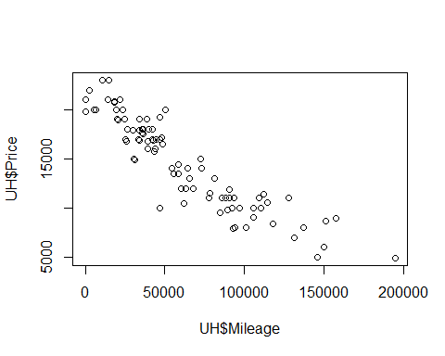
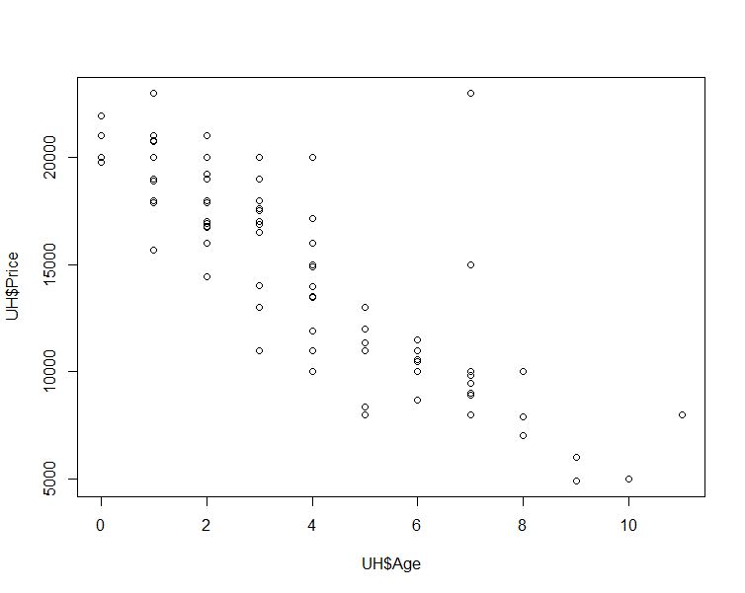
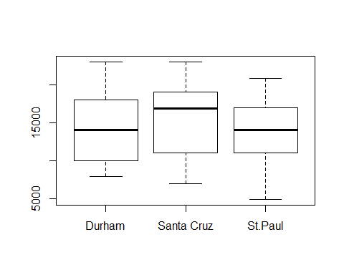
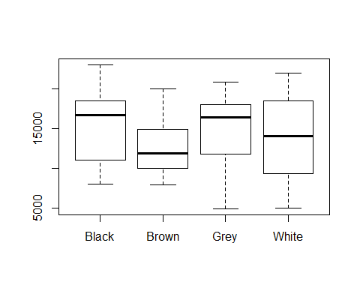
Plot data
Notes:
the model looks more like a first order model with dummy variable and maybe interactive terms.

Slide 4
Search best model
The model looks more like a first order model with dummy variable and probably interactive terms.
Use best subset to search best model
Try:
  First order model with/without interaction
  Second order model with/without interaction
  Third order model with/without interaction
Pick up best model depending on:
  AdjR^2 (>85%)
  Cp (Cp=p, and small)
  beta significance (<0.05)
  percent error (-10%,10%)
Notes:
the model looks more like a first order model with dummy variable and maybe interactive terms.

Slide 5
Search best model
model1: Price~Mileage+Age+C2 Cp=4.5, adjR^2=0.87
model2: Price~Mileage+Age+C2+L1 Cp=3.0, adjR^2=0.88
model3: Price~Mileage+Age+C1+C2+C3+L1+L2 Cp=8.0, adjR^2=0.87
in.model1: Price~Mileage+Age+C2+L1+M_A Cp=4.6, adjR^2=0.88
in.model2: Price~Mileage+Age+C2+L1+L2+M_A Cp=6.4, adjR^2=0.88
in.model3: Price~Mileage+Age+C1+C2+C3+L1+L2+M_A Cp=9.0, adjR^2=0.88
sq.model1: Price~Mileage+L1+M_A+M_SQ Cp=4.8, adjR^2=0.90
sq.model2: Price~Mileage+C2+M_A+M_SQ Cp=5.4, adjR^2=0.89
sq.model3: Price~Mileage+C2+L1+M_A+M_SQ Cp=3.4, adjR^2=0.90
sq.model4: Price~Mileage+Age+C1+C2+C3+L1+L2+M_A+M_SQ+A_SQ
Cp=11, adjR^2=0.89
cu.model1: Price~Mileage+C2+L1+M_A+M_CU+A_CU Cp=3.8, adjR^2=0.90
cu.model2: Price~Mileage+Age+C1+C2+C3+L1+L2+M_A+M_SQ+A_SQ+M_CU+A_CU
Cp=13, adjR^2=0.90
Notes:
the model looks more like a first order model with dummy variable and maybe interactive terms.

Slide 6
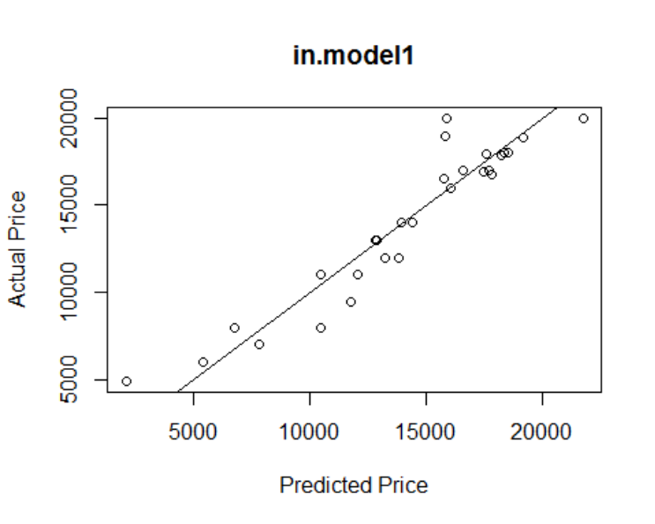
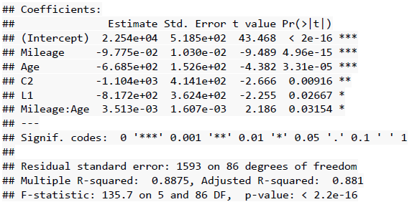
Best Model
After checking betas and percent errors, best model:
Price = 22540 - 0.09775*Mileage - 668.5*Age - 1104*C2 - 817.2*L1 + 0.003513*Mileage*Age
All p-value of betas < 0.05
p-value of model < 0.05
Percent error: -2.77%
Notes:
the model looks more like a first order model with dummy variable and maybe interactive terms.

Slide 7
What does this model tell us
Sale Price = 22540 - 0.09775*Mileage - 668.5*Age - 1104*C2 - 817.2*L1
+ 0.003513*Mileage*Age
C2: 1 or 0; =1 means brown color, 0 means not brown (white, black, grey)
    L1: 1 or 0; =1 means in St. Paul, 0 means not St. Paul (Durham, Santa Cruz)
Once you drive your Honda, it loses value.
(- 0.09775+ 0.003513*Age) *Mileage
Even you just park your Honda and never drive it, it loses value.
(- 668.5 + 0.003513*Mileage)*Age
If not really a huge fan of brown, choose a different color for your Honda. The car would worth a better price when you sell it. (- 1104*C2 )
If it is possible, do not sell in St. Paul. Try Durham, Santa Cruz. (Long trip…Hmm)
(- 817.2*L1)
5. Get ready for lose car value no matter what, when you by it. ☹
Notes:
the model looks more like a first order model with dummy variable and maybe interactive terms.

